Slide 1
Multi-Branch Business Performance Analysis
By:
Sai Lokesh M,

Slide 2
Problem we are trying to solve
Problem Statement & Motivation:
Despite having large volume of data, businesses struggle to explain sales performance variations across various branches and sales channels (Physical stores, online channels) and derive actionable insights from them
Reliance on multi-channel strategies to optimize sales and maximize revenue created the need of comprehensive analysis of the sales & retail data
Why it is important ?
Developing a visualized dashboard would help the businesses to present sales trends, identify performance drivers, and provide targeted recommendations for improved revenue & optimizing operations.

Slide 3
Approach & Expected Outcomes:
Use data analysis (EDA) to analyze sales data to identify key performance drivers
Create an interactive dashboard that integrates data sources to provide a comprehensive view of sales performance
Identify how different factors affect sales across branches and channels.
Deliver insights that can guide inventory management, marketing strategies, and customer engagement.

Slide 4
Data Analytics & Dashboard Process:
1
2
3
4
Data Cleaning
EDA
Tableau Dashboard
Findings and Recommendations
Analyse and clean the data. Handling missing & duplicate values.
Performing Exploratory Data Analysis (EDA) to identify key performance indices.
Prepare a Tableau dashboard to identify trends, patterns & business insights
Observe, analyse and summarise key findings and make recommendations

Slide 5
Dataset description
About the data:
We are using sales data of a retail store which has online and physical presence across India. It consist of 2 datasets: ‘Orders.csv’ & ‘Details.csv’.
Orders.csv contain information about customer orders, such as order date, mode of order, customer details etc.,
Some of the key attributes from 'Orders' are:
  Order ID: A unique identifier for each order.
  Order Date: The date the order was placed.
  State: The state where the order was placed or shipped to.
  Order Mode: The method used to place the order (e.g., online, in-store).

Slide 6
Details.csv contain information about the items included in each order, such as product category, payment method, amount, and profit.
Some of the key attributes from ‘Details’ are:
  Order ID: Links to the order ID in ‘Orders’ dataset - Primary key in both the datasets.
  Category: The product category of the item.
  Payment Mode: The payment method used for the order.
  Amount: The total amount of the order (revenue)
  Profit: The profit made on the order.
The dataset consists of approximately 1500 rows of sales data in 21 states of India.

Slide 7
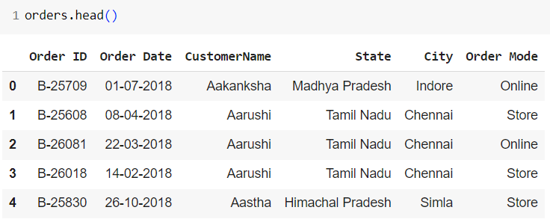
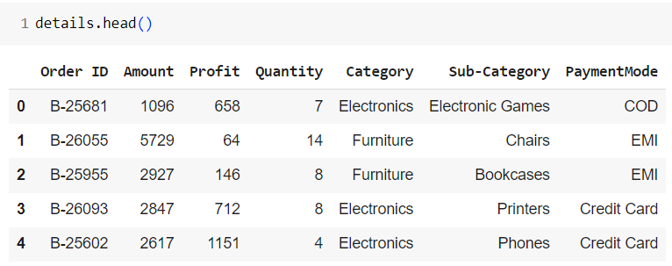
Image on the left shows the sample data from ‘Orders’ dataset, and on the right shows the sample data from ‘Details’ dataset
‘Order ID’ is the primary key for both the dataset.

Slide 8
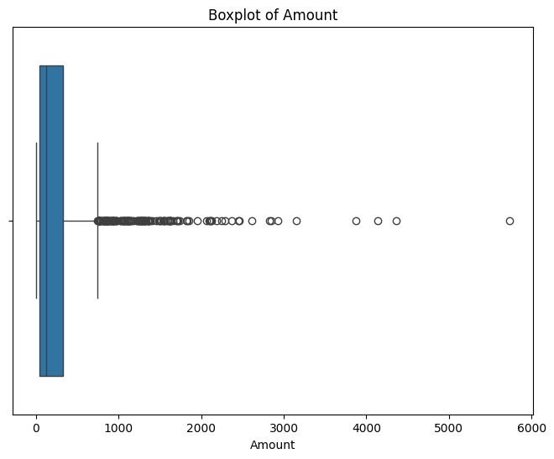
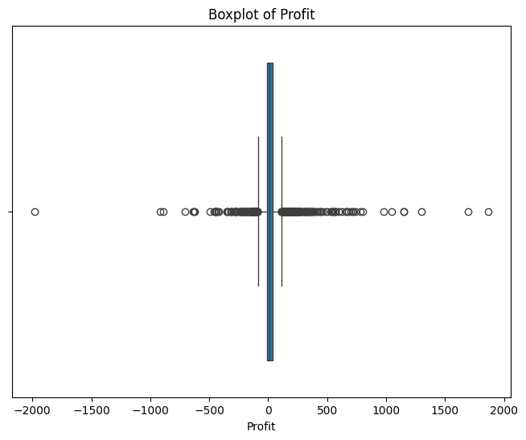
Data Preprocessing
The data does not have any missing values, NaN values or duplicate rows. So, we were not needed to perform missing value treatment
For our Tableau dashboard (in next slides), we’ve wanted few more columns like ‘AOV’ (Average Order Value), and we’ve created them using existing columns
‘Amount’ & ‘Profit’ seems to have values far off from 99th percentile, but we’ve decided not to remove them as these data points (when reviewed) belongs to different categories and removing them or modifying them might mislead our analysis

Slide 9
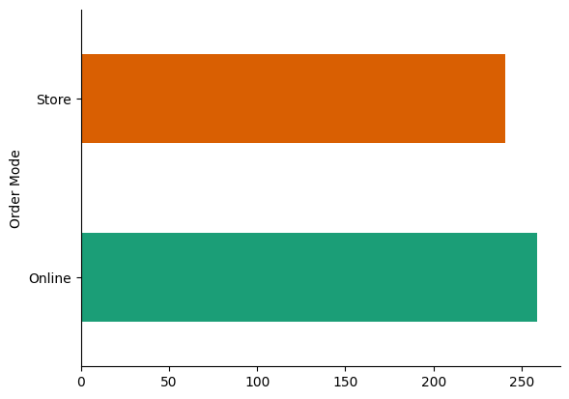
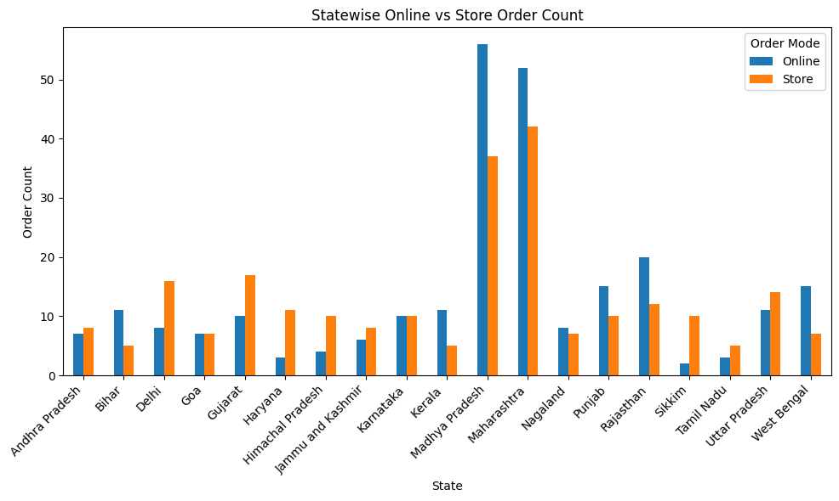
EDA & Descriptive Statistics:
We’ve performed exploratory data analysis using python’s matplotlib & seaborn library on various attributes of the data
Plot on left shows that, customers are preferring ‘Online’ mode of purchase than ‘In-Store’ mode.
From the plot on the right, it is clearly evident that states with strong telecommunication infrastructure tend to have higher rates of online purchases
Maharashtra & Madhya Pradesh leads the overall sales, which tells us that sales are directly proportional to the state’s population as these two are the most populous states of India, and so highest sales

Slide 10
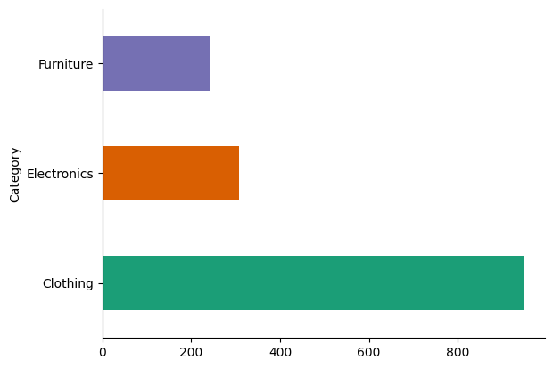
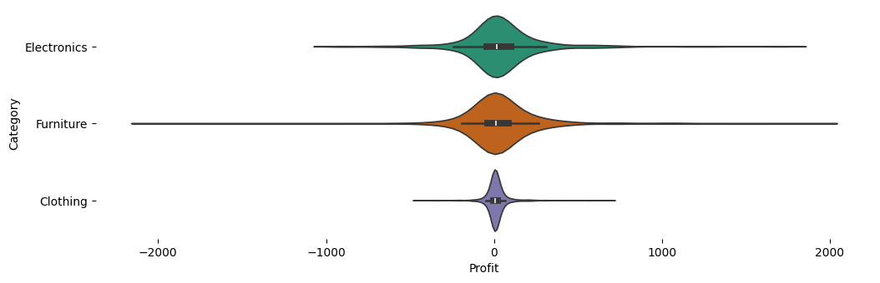
EDA & Descriptive Statistics:
Analysis on ‘Details.csv’ shows that ‘Clothing’ category has the highest sales followed by electronics, and furniture with the least sales
However, ‘Furniture’ category has the highest profit variance and ‘Clothing’ with the least profit variance. This clearly tells us that ‘Furniture’ item despite having less sales generate huge profits

Slide 11
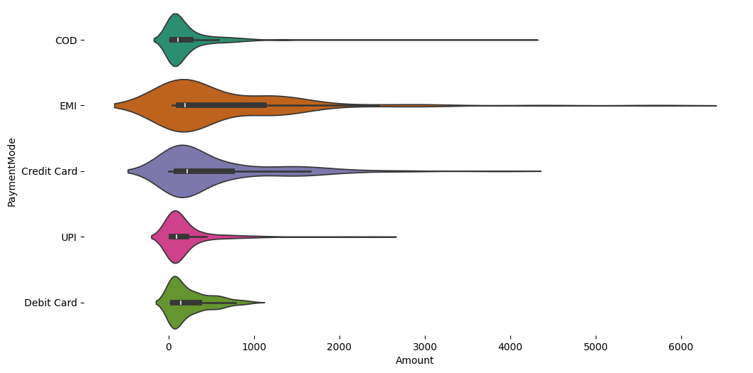
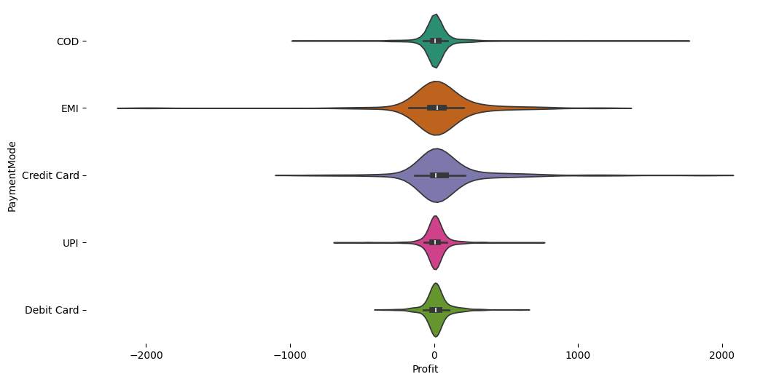
EDA & Descriptive Statistics:
Above plot shows the variance in ‘PaymentMode’ with ‘Amount’ (or Revenue) & ‘PaymentMode’ with ‘Profit’. From the above plot we can say that, customers are preferring ‘EMI’ or ‘Credit Card’ mode of payment when purchasing items (which are generating high revenue).
However, losses are also high for sales with ‘EMI’ or ‘Credit Card’ mode of payment. So there is significant risk involved with allowing ‘EMI’ or ‘Credit Card’ despite generating high revenues & profits.

Slide 12
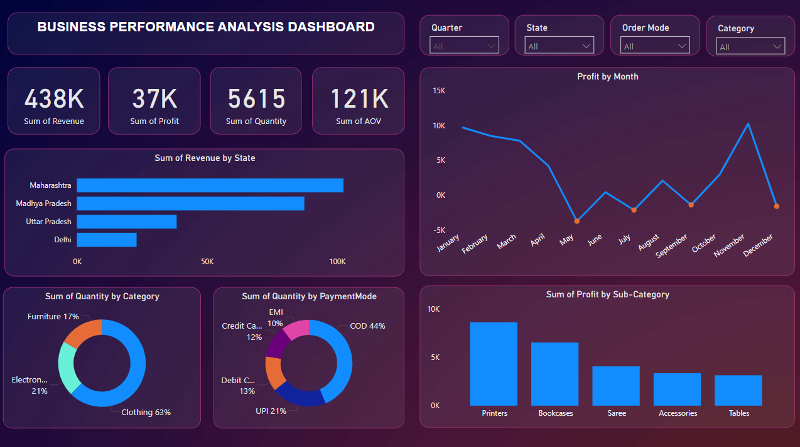
Tableau Dashboard

Slide 13
How this dashboard solves the problem ?
The dashboard provides actionable insights for business in decision-making by summarizing performance metrics and trends. We’ve provided Filters for Quarter, State, Order Mode, and Category to allow granular analysis, enabling targeted decision-making for specific time periods, locations, and product categories.
Here’s how this dashboard helps the business and solves the problem:
Revenue and Profit Analysis:
The total revenue (438K) and profit (37K) metrics give a high-level view of business performance.
Understanding the monthly profit trend helps identify seasonal patterns or anomalies, enabling better financial planning.
State-Level Insights:
The Sum of Revenue by State chart highlights top-performing regions, such as Maharashtra, allowing businesses to focus resources on high-performing areas and address challenges in low-performing regions.

Slide 14
How this dashboard solves the problem ?
Category and Payment Analysis:
The Sum of Quantity by Category pie chart reveals what category contributes the most (clothing - 63%), guiding inventory management and marketing strategies.
The Sum of Quantity by Payment Mode chart shows what Payment Mode works most in different demographics, and helping business in improving infrastructure & options, if needed.
Sub-Category Profit Insights:
The Sum of Profit by Sub-Category bar chart identifies profitable sub-categories like printers and bookcases, helping prioritize stock for high-margin items and managing inventory based on trends.

Slide 15
Benefits for business
Optimized Resource Allocation: Business can focus efforts on high-performing states, categories, and payment modes to maximize their revenue & profits.
Marketing Strategy Improvement: Marketing team can align campaigns with top categories and preferred payment methods.
Seasonal Planning: Inventory team can utilize monthly trends for demand forecasting and promotions & handle the inventory efficiently
Enhanced Customer Experience: Company can improve service by addressing regional preferences and operational bottlenecks.
Profit Maximization: Business may prioritize profitable sub-categories and minimize losses in underperforming areas.

Slide 16
Findings:

Slide 17
Findings & recommendations:
Focus on Maharashtra and Madhya Pradesh: These states have the highest revenue potential. Additional marketing or promotional campaigns might yield better results.
Clothing as a Key Segment: Given its large share in quantity sold, increasing product variety or improving distribution channels can boost sales further.
Expand Payment Options: Although COD dominates, increasing incentives for digital payment modes (like UPI) might reduce operational risks and costs.
Optimize Sub-Categories: Explore ways to boost profitability in underperforming sub-categories like Accessories and Tables.

Slide 18
Customers are preferring ‘Online’ mode of purchase than ‘In-Store’ mode, so business should improve infrastructure for online sales
‘Furniture’ item despite having less sales generate huge profits
Customers prefer to buy costlier items in “EMI” or “Credit Card” mode of payment, and generate high revenue as well. So, Business should make these options available. And since losses are high for these modes of payment, business should take utmost care
Business should focus on Maharashtra & Madhya Pradesh, since these two states are generating highest revenues and profits
Inventory team should make ‘Clothing’ items available for Quarter 1 as clothing items are sold most in Q1
‘Electronic games’ are generating losses almost all of the quarters, so business should reduce the supply for this category

Slide 19
Key concepts & techniques that we learnt:
Data preprocessing techniques
Exploratory Data Analysis from the lens of technical domain (Sales here)
Importance of understanding the data
Tableau tool & dashboard

Slide 20
THANK YOU

